Slide 1
G2M Case Study Virtual Internship
Soulaiman KACHA

Slide 2
Background
XYZ is a private firm in US. Due to remarkable growth in the Cab Industry in last few years and multiple key players in the market, it is planning for an investment in Cab industry and as per their Go-to-Market(G2M) strategy they want to understand the market before taking final decision.
• Objective : Provide actionable insights to help XYZ firm in identifying the right company for making investment.
The analysis has been divided into three parts:
• Data Understanding
• Forecasting profit and number of Users
• Finding the most profitable Cab company

Slide 3
Data Exploration
Cab_Data.csv – this file includes details of transaction for 2 cab companies
Customer_ID.csv – this is a mapping table that contains a unique identifier which links the customer’s demographic details
Transaction_ID.csv – this is a mapping table that contains transaction to customer mapping and payment mode
City.csv – this file contains list of US cities, their population and number of cab users
After exploring the four datasets understanding the names of the columns and identifying the relationships between them, we proceed to create a master dataset joining and ordering all the four previous dataset we have.

Slide 4
Data Exploration
Transaction ID and Customer ID: variables that are only used to identify each record, and that almost certainly will never be used in any statistical analysis (name or ID number of a person, for example).
Gender: Qualitative Binary variable with two levels of the factor (Male/Female).
Age: Quantitative Discrete variable
Income: Quantitative Continuous variable. Income per month of each client in USD
Company: Qualitative Variable (Binary). The Pink cab company and yellow cab company.
City: Qualitative Nominal Variable. The cities where the two cab companies operate. 20 factors for this variable.
Population: Quantitative Discrete variable. Number of people of each city.
Users: Quantitative Discrete variable. Number of Users os the cab companies of each city.
Date of travel: Quantitative continuous variable
Km travelled: Quantitative continuous variable. KM travelled in each trip made.
Price charged: Quantitative continuous variable. Price in USD charged in each Trip.
Cost of Trip: Quantitative continuous variable. Cost in USD of each Trip.
Payment Mode: Qualitative Binary variable. Method of payment (Cach/Credit card)

Slide 5
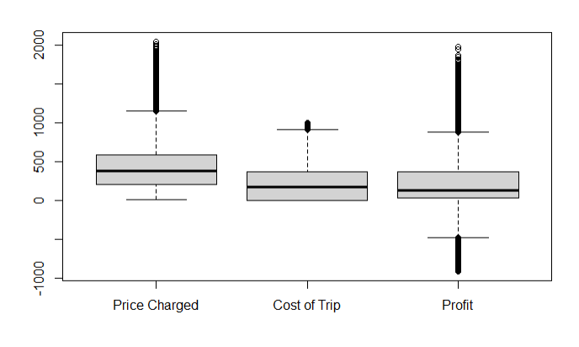
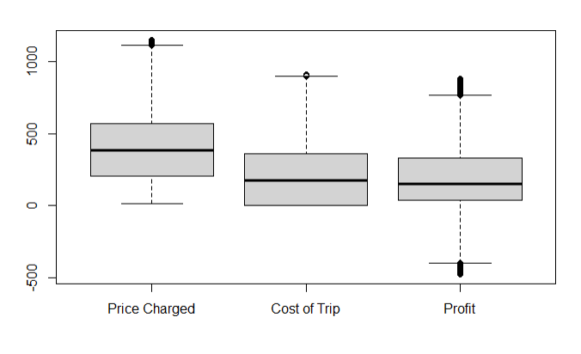
Outliers detection and treatment
We found outliers for the variables Price charged, Cost of the trip and the variable we created called Profit.

Slide 6
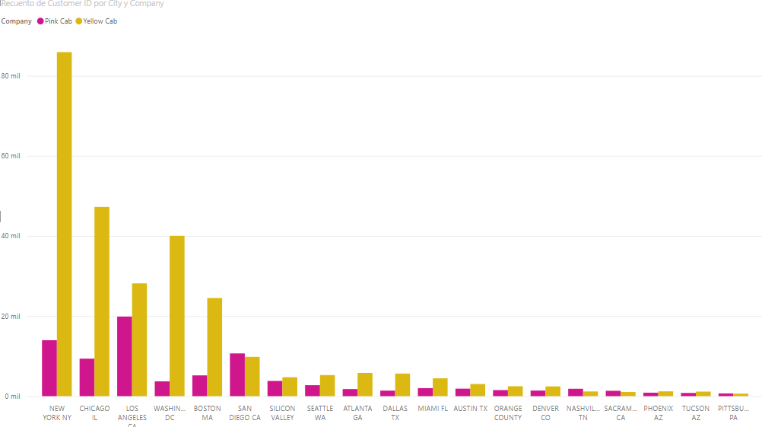
Customer Presence of Yellow and Pink cab city wise
We found that the Yellow company has way much customers per city than the pink company.
New York, Los angeles and Washington are the cities with more Users for the yellow company
Los angeles, New york and San Diego are the cities with more Users for the Pink company

Slide 7
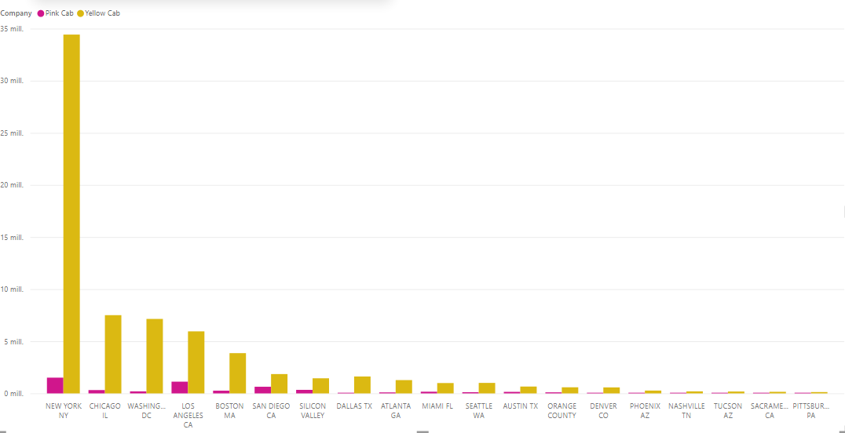
Profit of Yellow and Pink cab city wise
Yellow company seems to have a bigger profit per city than Pink company.
The number of users are different for each company
We have to study also the profit per user for each city

Slide 8
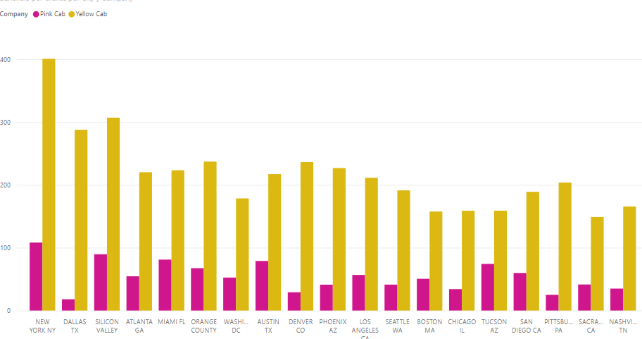
Profit per User of Yellow and Pink cab city wise
Indeed the yellow company generates more Profit for each user than the Pink company

Slide 9
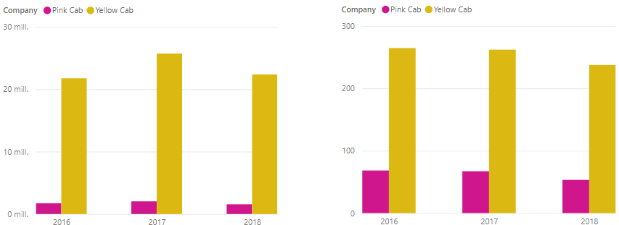
Profit and profit per client by Company Year wise
Profit by company Year wise
Profit per client by company year wise

Slide 10
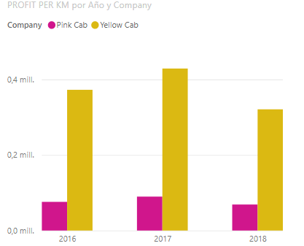
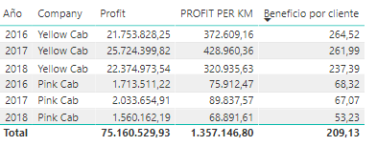
Profit per KM year wise
Yellow company has bigger profit year wise then pink company
Yellow company has bigger profit per Km year wise then pink company
Yellow company has bigger profit per client year wise then pink company
Profit per KM year wise

Slide 11
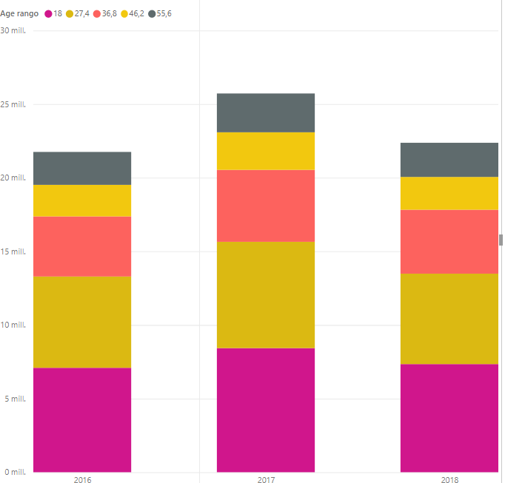
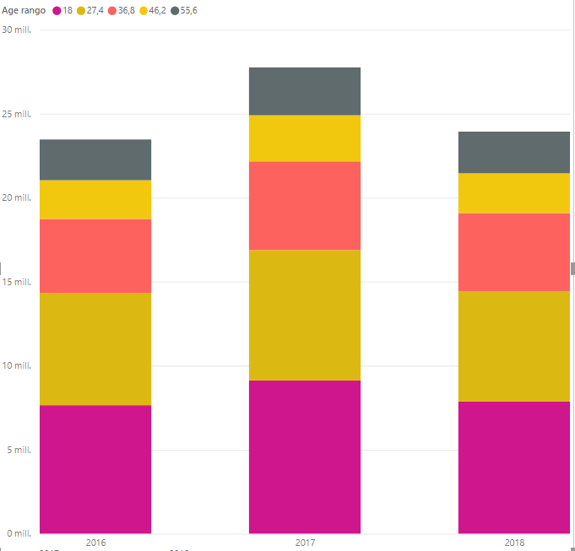
Age GroupWise Profit And Customer Base
The users who most use both companies are in the age ranges between 18 and 35 years. As the age ranges increase, the use of both companies decreases, being the age range <65 the one that uses the least
Yellow company
Pink company

Slide 12
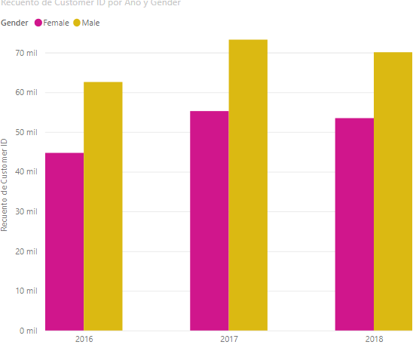
Customer base Analysis Gender wise
It seems that the gender that most uses transport services are men

Slide 13
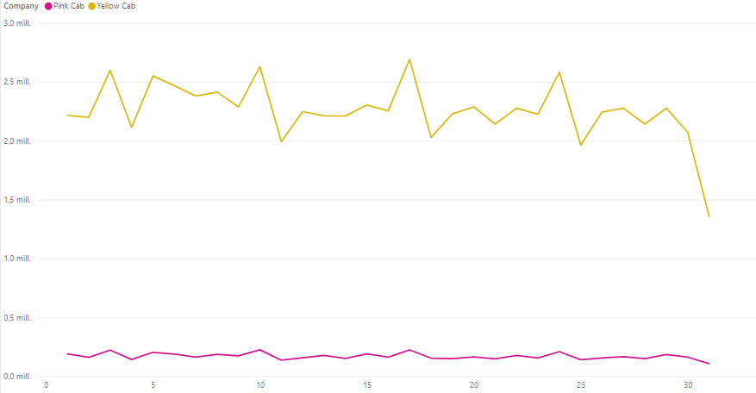
Seasonality
There seems to be a clear seasonality.
The pattern is repeated every 7 days where one of the days has the highest peak followed by the lowest peak.
This makes us think of a very high use on Sundays, followed by a decrease on Monday,

Slide 14
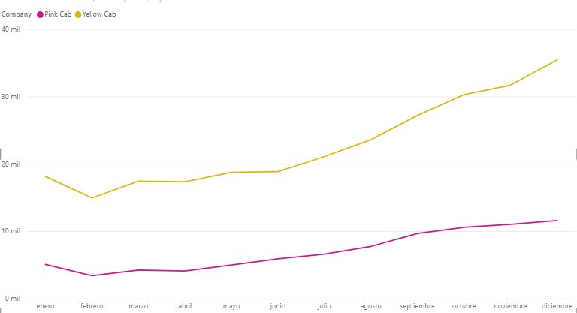
Year production
We can see that the months with the lowest production are those of the first four months of the year, especially February. The number of users increases in the second quarter and sees its greatest exponent in the last quarter of the year

Slide 15
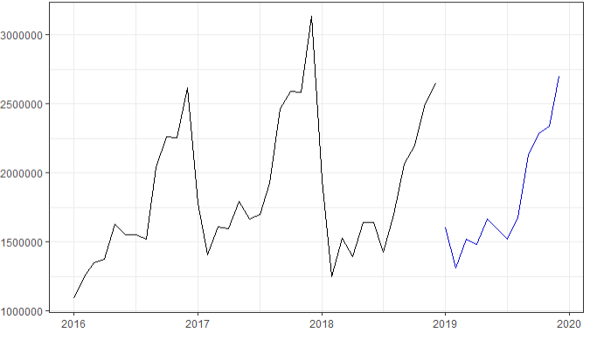
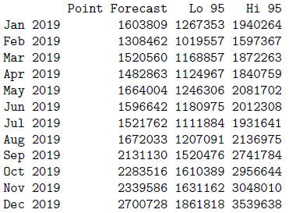
Profit forecasts Yellow cab

Slide 16
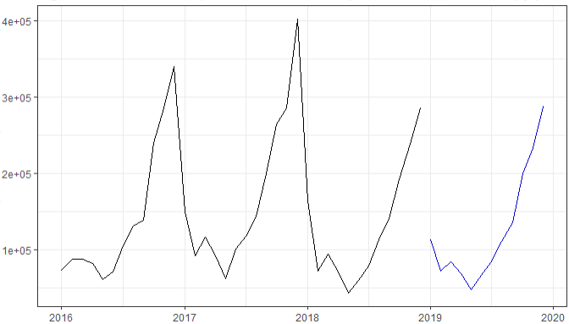
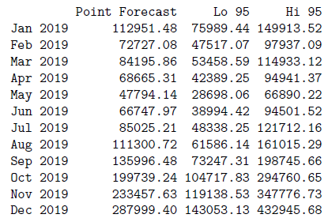
Profit forecasts Pink cab

Slide 17
Recommendations
After conducting an exhaustive analysis, we have determined that the yellow company is more suitable to invest in it for the following reasons:
Customer Reach : Yellow cab has higher customer reach in cities then Pink cab.
Generated profit: The Yellow cab company generates more profit in most cities and over the years than the pink company
Profit per KM: Yellow cab manage to generate more profit per Km than Pink cab
Future Profit: Forecast of future profit shows the Yellow cab is going to generate much more profit than pink cab

